Slide 1
22~23. Dynamic Data Structure and Generics (2)
[ECE200016/ITP20003] Java Programming
Notes:
‹#›

Slide 2
Agenda
Array-based Data Structures
The Java Collections Framework
Linked Data Structures
Generics

Slide 3
Array-based Data Structures
https://docs.google.com/presentation/d/1JZFEG4B8XuwXqTLgYhOvcLCgFkgBhS8uiNQRU_gyGgg/edit#slide=id.p3

Slide 4
Agenda
Array-based Data Structures
The Java Collections Framework
Linked Data Structures
Generics

Slide 5
The Java Collections Framework
A collection of interfaces and classes that implement useful data structures and algorithms
The Collection interface specifies how objects can be added, removed, or accessed from a Collection
Brief introduction to just two implementations, HashSet and HashMap
See other references for more info

Slide 6
HashSet Class
Used to store a set of objects
Uses the same <> notation as an ArrayList to specify the data type
class HashSetDemo
https://github.com/HGUISEL/CollectionsExample/blob/master/src/main/java/edu/handong/csee/java/exmple/collections/HashSetDemo.java
If you use HashSet of your own class, it must override hashCode() and equals()

Slide 7
HashSetDemo
public void run()
{
HashSet<Integer> intSet = new HashSet<Integer>();
intSet.add(2);
intSet.add(7);
intSet.add(7); // Ignored since 7 is already in the set
intSet.add(3);
printSet(intSet); // method defined in the HashSetDemo class
intSet.remove(3);
printSet(intSet); // method defined in the HashSetDemo class
System.out.println("Set contains 2: " + intSet.contains(2));
System.out.println("Set contains 3: " + intSet.contains(3));
}

Slide 8
HashSetDemo
public void printSet(HashSet<Integer> intSet)
{
System.out.println("The set contains:");
for (Object obj : intSet.toArray())
{
Integer num = (Integer) obj;
System.out.println(num.intValue());
}
}

Slide 9
HashMap Class
https://docs.google.com/presentation/d/1JZFEG4B8XuwXqTLgYhOvcLCgFkgBhS8uiNQRU_gyGgg/edit#slide=id.p24

Slide 10
Agenda
Array-based Data Structures
The Java Collections Framework
Linked Data Structures
Generics

Slide 11
Class LinkedList
Linked data structure
Collection of objects
Each object contains data and a reference to another object in the collection
Java provides a class to do this, LinkedList
More efficient memory use than ArrayList
We will write our own version to learn the concepts of a linked list

Slide 12
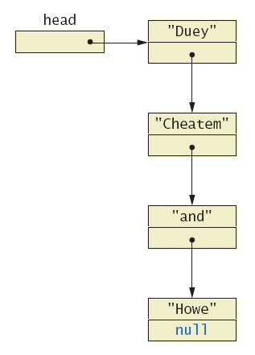
Linked Lists
A dynamic data structure
Links items in a list to one another

Slide 13
Linked Lists
Node of a linked list object requires two instance variables
Data
Link
class ListNode
https://github.com/lifove/CollectionsExample/blob/master/src/main/java/edu/handong/csee/java/exmple/collections/linkedlist/ListNode.java
This example has String data
Note the link, a reference to the type which is the class

Slide 14
Linked Lists
public class ListNode
{
private String data;
private ListNode link;
public ListNode ()
{
link = null;
data = null;
}
public ListNode (String newData,
ListNode linkNode)
{
data = newData;
link = linkNode;
}
public void setData (String newData)
{
data = newData;
}
public String getData ()
{
return data;
}
public void setLink (ListNode newLink)
{
link = newLink;
}
public ListNode getLink ()
{
return link;
}
}

Slide 15
Implementing Operations of Linked Lists
Now we create a linked list class which uses the node class
class StringLinkedList
https://github.com/lifove/CollectionsExample/blob/master/src/main/java/edu/handong/csee/java/exmple/collections/linkedlist/StringLinkedList.java
Note the single instance variable of type ListNode
private ListNode head;
Note method to traverse and print the contents of the list
ListNode position = head;
while (position != null) {
System.out.println (position.getData ());
position = position.getLink ();
}

Slide 16
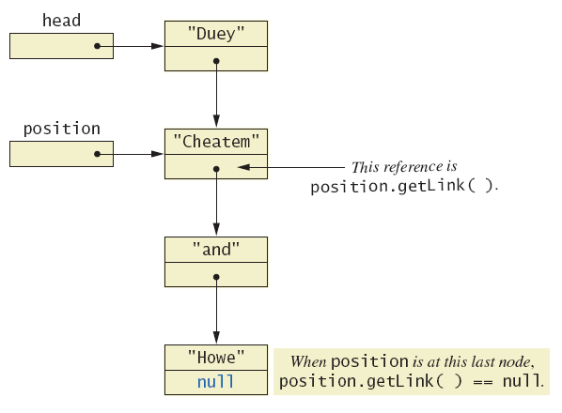
Implementing Operations of Linked Lists
Moving down a linked list

Slide 17
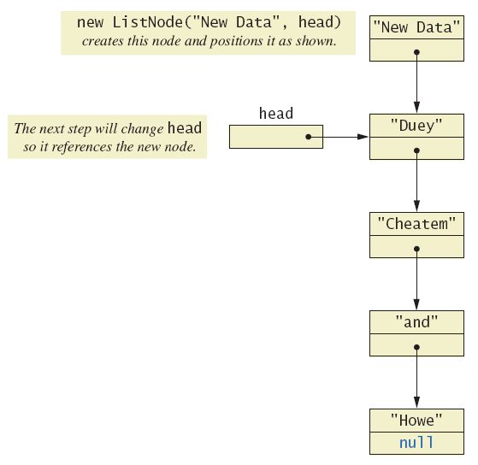
Implementing Operations of Linked Lists
Adding a node at the start of a linked list

Slide 18
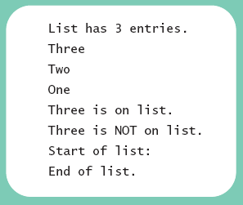
Implementing Operations of Linked Lists
class StringLinkedListDemo
https://github.com/lifove/CollectionsExample/blob/master/src/main/java/edu/handong/csee/java/exmple/collections/linkedlist/LinkedListDemo.java

Slide 19
StringLinkedListDemo
public class StringLinkedListDemo
{
public static void main (String [] args)
{
StringLinkedList list = new StringLinkedList ();
list.addANodeToStart ("One");
list.addANodeToStart ("Two");
list.addANodeToStart ("Three");
System.out.println ("List has " + list.length () + " entries.");
list.showList ();
if (list.onList ("Three"))
System.out.println ("Three is on list.");
else
System.out.println ("Three is NOT on list.");
list.deleteHeadNode ();
if (list.onList ("Three"))
System.out.println ("Three is on list.");
else
System.out.println ("Three is NOT on list.");
list.deleteHeadNode ();
list.deleteHeadNode ();
System.out.println ("Start of list:");
list.showList ();
System.out.println ("End of list.");
}
}

Slide 20
Implementing Operations of Linked Lists
Java automatically returns memory used by deleted node to the operating system.
Called automatic garbage collecting
public void deleteHeadNode ()
{
if (head != null)
// only disconnects it from the linked list, not dellocating the node
head = head.getLink ();
else {
System.out.println ("Deleting from an empty list.");
System.exit (0);
}
}

Slide 21
NullPointerException
NullPointerException messages indicates
Your code tried to use a variable of a class type to reference an object, but the variable contains null.
A NullPointerException is one of the exceptions that you do not need to catch in a catch block or declare in a throws clause.
Instead, it indicates that you need to fix your code.

Slide 22
A Privacy Leak
Note results of getLink in class ListNode
Returns reference to ListNode
This is a reference to an instance variable of a class type … which is supposed to be private
Typical solution is to make ListNode a private inner class of StringLinkedList

Slide 23
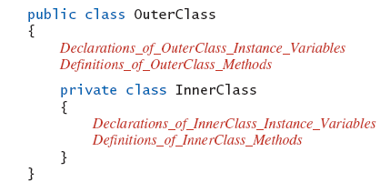
Inner Classes
Defined within other classes
Ex)

Slide 24
Inner Classes
Inner class definition local to the outer-class definition
Inner-class definition usable anywhere within definition of outer class
Methods of inner and outer classes have access to each other's methods, instance variables

Slide 25
Node Inner Classes
We show ListNode as a private inner class
This is safer design
Hides method getLink from world outside StringLinkedList definition
class StringLinkedListSelfContained
https://github.com/lifove/CollectionsExample/blob/master/src/main/java/edu/handong/csee/java/exmple/collections/linkedlist/StringLinkedListSelfContained.java

Slide 26
Iterators
A variable that allows you to step through a collection of nodes in a linked list
For arrays, we use an integer
Common to place elements of a linked list into an array
For display purposes, array is easily traversed
method toArray

Slide 27
toArray Method
public String [] toArray ()
{
String [] anArray = new String [length ()];
ListNode position = head;
int i = 0;
while (position != null) {
anArray [i] = position.data;
i++;
position = position.link;
}
return anArray;
}

Slide 28
Iterators
Consider an iterator that will move through a linked list
Allow manipulation of the data at the nodes
Allow insertion, deletion of nodes
class StringLinkedListWithIterator
https://github.com/lifove/CollectionsExample/blob/master/src/main/java/edu/handong/csee/java/exmple/collections/linkedlist/StringLinkedListWithIterator.java

Slide 29
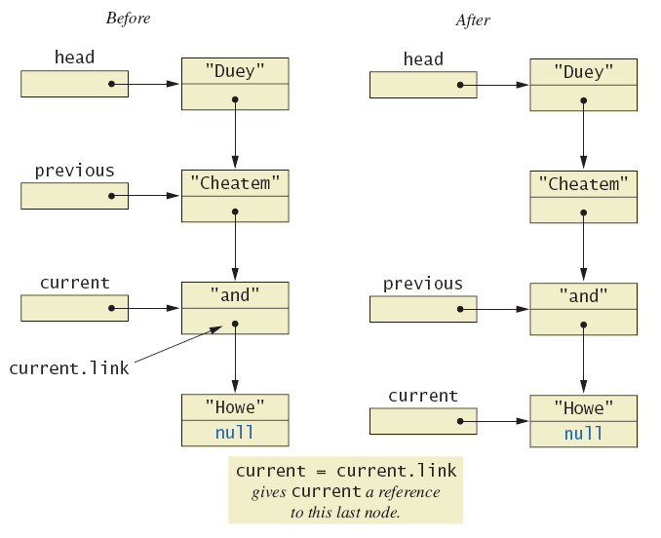
Iterators
The effect of goToNext on a linked list

Slide 30
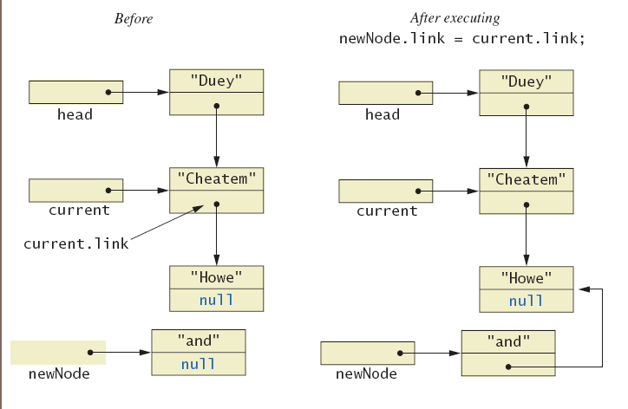
Iterators
Adding node to linked list using insertAfterIterator

Slide 31
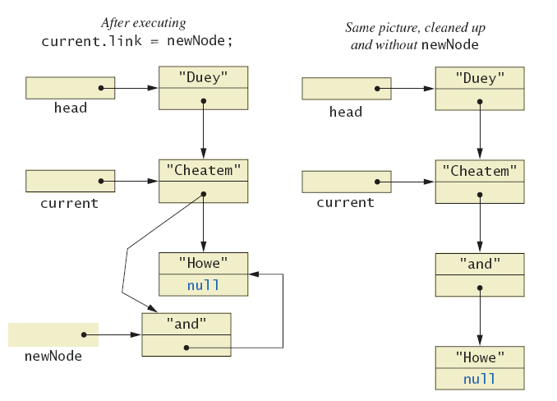
Iterators
Adding node to linked list using insertAfterIterator

Slide 32
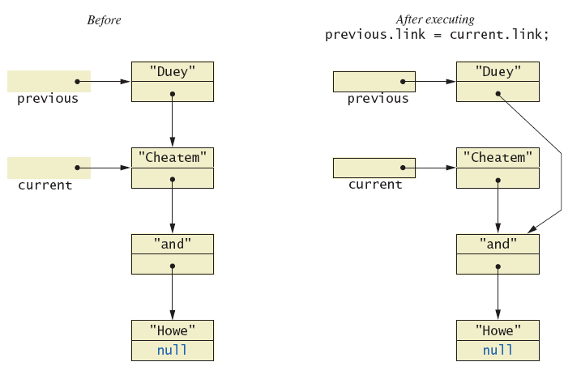
Iterators
Deleting a node

Slide 33
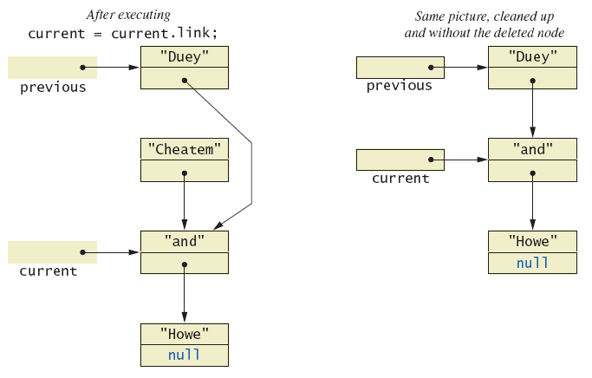
Iterators
Deleting a node

Slide 34
Java Iterator Interface
Java formally considers an iterator to be an object
Note interface named Iterator with methods
hasNext – returns boolean value
next – returns next element in iteration
remove – removes element most recently returned by next method

Slide 35
Exception Handling with Linked Lists
Recall class StringLinkedListWithIterator
Methods written so that errors caused screen message and program end
More elegant solution is to have them throw exceptions
Programmer decides how to handle

Slide 36
Class LinkedListException
class LinkedListException
public class LinkedListException extends Exception
{
public LinkedListException ()
{
super ("Linked List Exception");
}
public LinkedListException (String message)
{
super (message);
}
}

Slide 37
Variations on a Linked List
Possible to make a linked where data element is of any type
Replace type String in definition of node class with desired data type
Consider keeping a reference to last node in list
Called the tail of the list
Constructors, methods modified to accommodate new reference

Slide 38
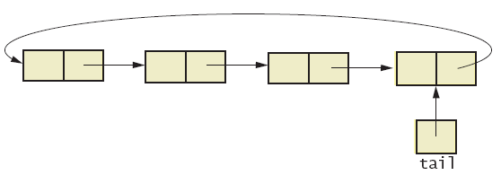
Variations on a Linked List
Consider having last link point back to head
Creates a circular linked list
Circular linked list

Slide 39
Variations on a Linked List
Also possible to have backward as well as forward links in the list
Doubly linked list
Possible to traverse in either direction
Doubly linked list

Slide 40
Other Linked Data Structures
Stack
Elements removed from ADT in reverse order of initial insertion
Can be implemented with linked list
Tree
Each node leads to multiple other nodes
Binary tree leads to at most two other nodes

Slide 41
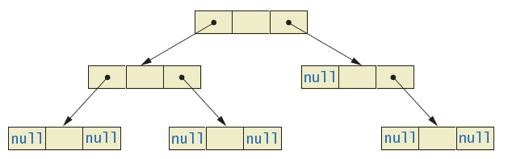
Other Linked Data Structures
Binary tree

Slide 42
Agenda
Array-based Data Structures
The Java Collections Framework
Linked Data Structures
Generics

Slide 43
Basics of Generics
Beginning with Java 5.0, class definitions may include parameters for types
Called generics
Programmer now can specify any class type for the type parameter
public class Sample<T>
{
private T data;
public void setData (T newValue)
{
data = newValue;
}
public T getData ()
{
return data;
}
}

Slide 44
Basics of Generics
Legal to use parameter T almost anywhere you can use class type
Cannot use type parameter when allocating memory such as anArray = new T[20];
Ex) Sample <String> sample1 = new Sample<String>();
Cannot specify a primitive type for the type parameter

Slide 45
Programming Example
Generic linked list
Revision of previous StringLinkedList example
Use type parameter E instead of String
Note similarities and differences of parameterized class with non-paramaterized classes
class LinkedList <E>
https://github.com/lifove/CollectionsExample/blob/master/src/main/java/edu/handong/csee/java/exmple/collections/linkedlist/LinkedList.java

Slide 46

Programming Example
class LinkedListFinalDemo
https://github.com/lifove/CollectionsExample/blob/master/src/main/java/edu/handong/csee/java/exmple/collections/linkedlist/LinkedListFinalDemo.java

